Slide 1
OBJECTS
IN JAVASCRIPT

Slide 2
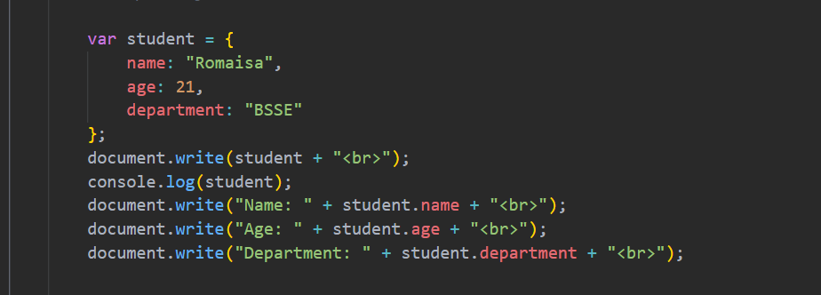
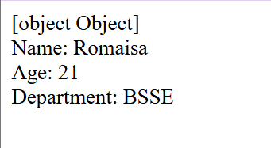
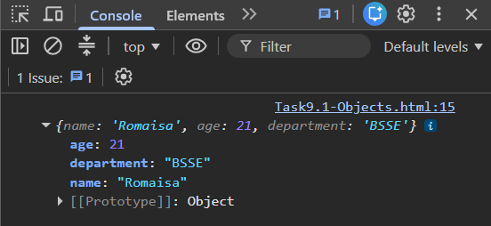
WHAT IS AN OBJECT?
It is a way to store related information about one thing in a single variable. It stores information as properties and their values in a key-pair values to keep the data in an organized manner.
The object literal is the simplest and most common way to create an object using curly braces {}.

Slide 3
Why we use console.log() and not document.write() to print?
If document.write() is used, it thinks that Student is like a box that contains values, when document.write() is used the JavaScript is confused as to print what part of the information therefore it will print [object Object]. The object contains three properties. We use dot notation to access the value of each property:
document.write(“Student: “ + Student.name + “<br>”);
document.write(“Age: “ + Student.age + “<br>”);
document.write(“Department: “ + Student.department + “<br>”);
Therefore, we will use console.log() because it knows how to display objects in a readable formats. When we use console.log(Student); it will display the text on console in alphabetical order.
Why in alphabetical? It is because of Chrome DevTools that displays properties in a convenient way for inspection.

Slide 4
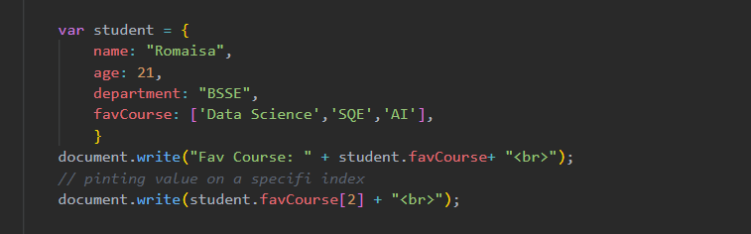
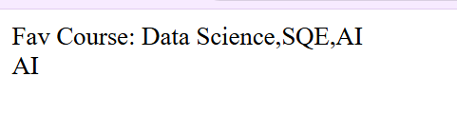
WHY DO WE USE OBJECTS?
The Objects help us store different pieces of related information in one place instead of creating multiple separate variables. Instead of creating separate variables for name, marks, and department, all information is stored inside one object, making the code easier to read and manage.
ARRAY IN AN OBJECT
OUTPUT:

Slide 5
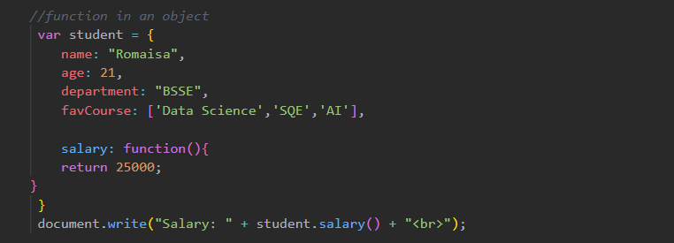

Objects can store different types of data, including arrays. In this example, the favCourse property contains an array of course names. We can display the complete array or access a specific course using its index number. Here, student.favCourse[2] returns AI, which is the third course in the array.
FUNCTION INSIDE AN OBJECT (OBJECT METHOD)
A function created inside an object is called a Method or Object Method.
OUTPUT:

Slide 6
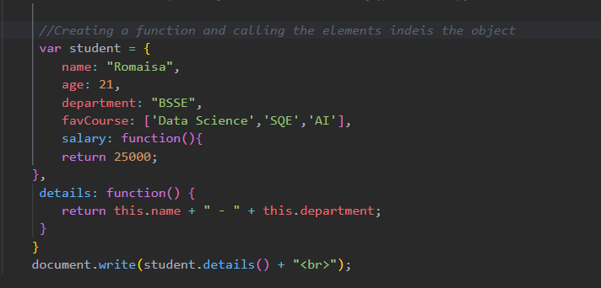
Objects can also contain functions, which are known as methods. These methods perform tasks related to that object. In this example, the salary() method returns the value 25000 whenever it is called. Methods allow objects to store both data and the actions that can be performed on that data.
THE ‘this' KEYWORD
The this keyword refers to the current object.

Slide 7

The this keyword is used to access the properties of the current object. In this example, this.name refers to the student's name, and this.department refers to the student's department. The details() method combines both values and returns them as a single string.
NESTED OBJECTS (OBJECT INSIDE OBJECT)
Objects can contain other objects to organize related information. This is called a nested object. In this example, the living object stores the student's city and country. We use student.living.country to access the country, which displays Pakistan.

Slide 8
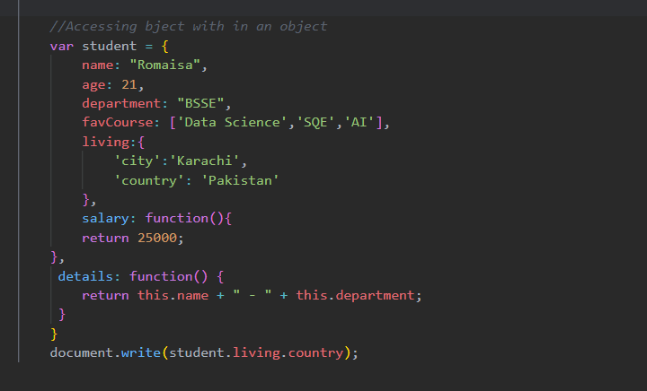

OUTPUT:

Slide 9
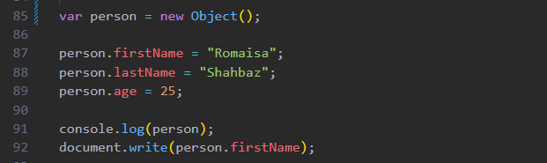
BUILT-IN OBJECT CONSTRUCTOR (NEW OBJECT()
The new Object() constructor is JavaScript's built-in method for creating an empty object.
The new Object() constructor first creates an empty object. After creating it, we add properties one by one. This approach is suitable when creating a single object, but it becomes repetitive if we need many objects with the same structure.

Slide 10
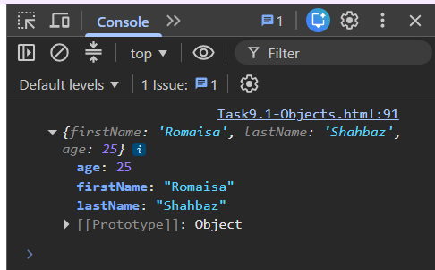

USER-DEFINED OBJECT CONSTRUCTOR
A user-defined object constructor is a function that acts as a blueprint for creating multiple objects with the same properties.

Slide 11
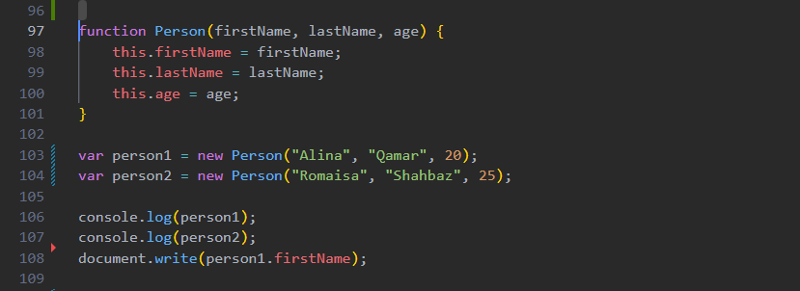
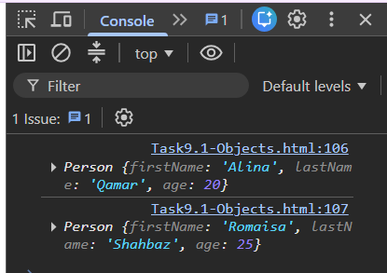


Slide 12
A user-defined constructor allows us to create many similar objects without repeating the same code. We define the structure only once and then use the new keyword to create multiple objects. This makes the code shorter, easier to maintain, and more organized.
DIFFERENCE BETWEEN BUILT-IN AND USER-DEFINED CONSTRUCTOR
Built-in Constructor | User-defined Constructor
Creates one empty object | Creates multiple similar objects
Properties are added manually | Properties are assigned automatically
Best for creating a single object | Best for creating many objects
Built into JavaScript | Created by the programmer

Slide 13
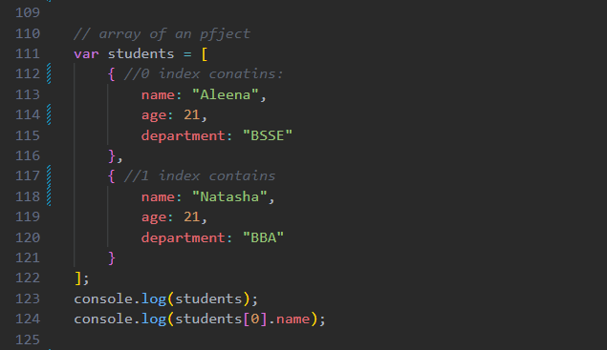
ARRAY OF AN OBJECT
An array of objects means storing multiple objects inside a single array. Here the objects act as the index.

Slide 14
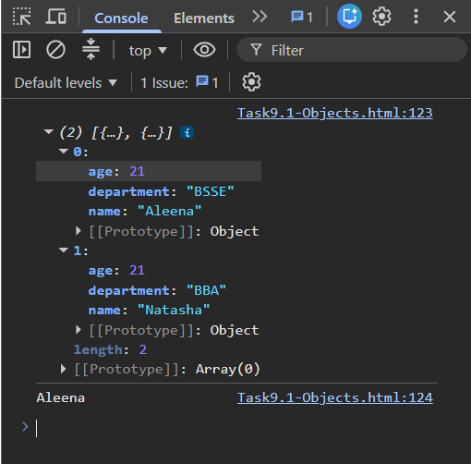
An array of objects is used to store multiple objects in one array. Each object contains its own properties and values. In this example, each object represents one student. We access the first student's name using students[0].name, which displays Aleena.

Slide 15
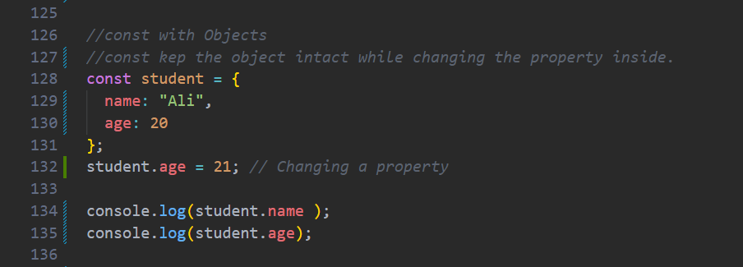
const WITH OBJECTS
The const keyword keeps the object fixed, but you can still change the data inside it.
When an object is declared using const, we cannot assign a completely new object to that variable. However, we can still update or modify the object's properties. In this example, the student's age changes from 20 to 21.

Slide 16
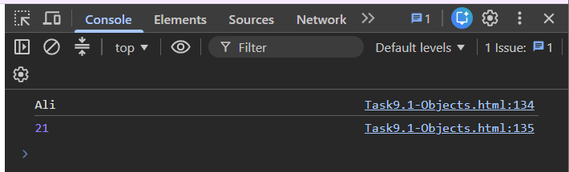
for/in LOOP WITH OBJECTS
The for/in loop is used to iterate through all the properties (keys) of an object. It accesses each property one by one, making it easy to read or display all the data stored inside an object.

Slide 17
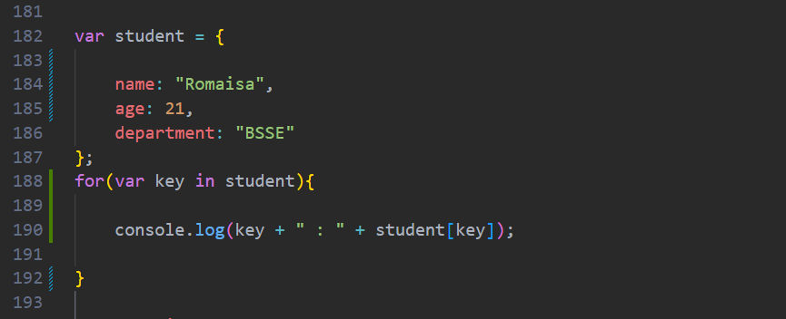
The for/in loop goes through every property of an object one by one. During each iteration, the variable key stores the name of the current property, such as name, age, or department. To get the value of each property, we use bracket notation (student[key]). This is because the property name is stored in a variable. The loop continues until all properties of the object have been accessed.

Slide 18
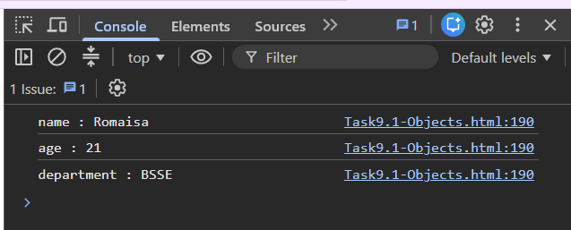
for/in LOOP WITH ARRAY OF OBJECTS
The for...in loop is used to go through the indexes (or keys) of an array or the properties of an object. In an array of objects, it accesses each object one by one using its index.

Slide 19
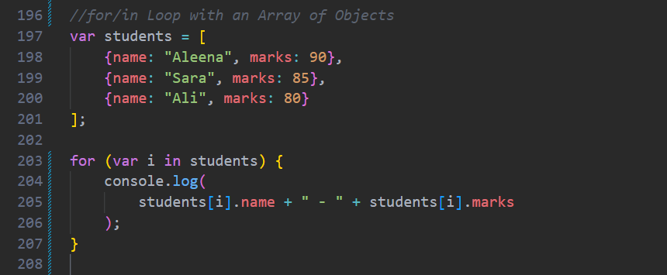
The for...in loop goes through each index of the students array (0, 1, and 2). In each iteration, students[i] accesses one object from the array. Then, students[i].name gets the student's name and students[i].marks gets the student's marks. The loop displays each student's information one by one.

Slide 20
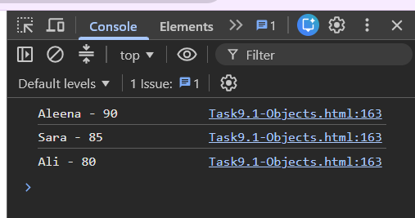
map() WITH OBJECTS
The map() method is an array method that is used to go through each object in an array, perform an operation on it, and return a new array with the results.

Slide 21
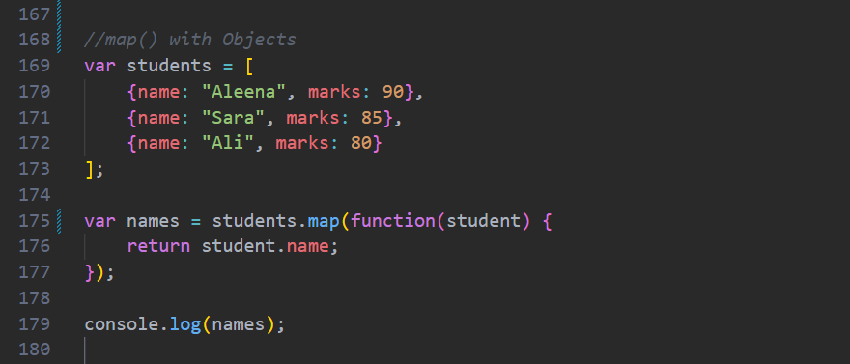
The map() method goes through each object in the students array one by one. Each object is stored in the student variable. The function returns only the name property of each object using student.name. After checking all the objects, map() creates a new array that contains only the names of the students. The original students array remains unchanged.

Slide 22
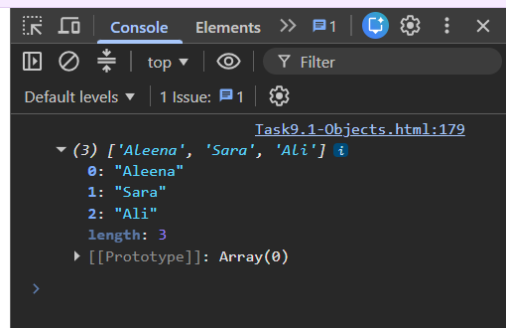
map() WITH ARRAY Of OBJECTS
The map() method creates a new array by applying a function to every element of an existing array

Slide 23
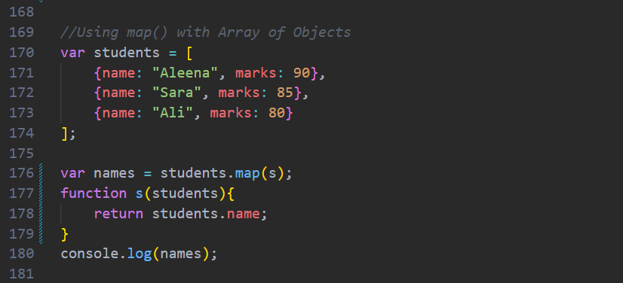
The map() method goes through each object in the students array one by one. Each object is passed to the function s(student), where student represents the current object. The function returns only the name of that object using student.name. After checking all the objects, map() creates a new array containing only the names. The output is ["Aleena", "Sara", "Ali"].

Slide 24
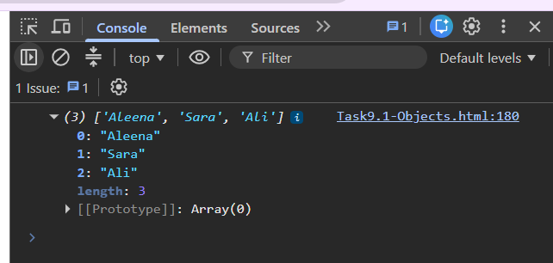

Slide 25
DIFFERENCE BETWEEN AN OBJECT & OBJECT CONSTRUCTOR
Object | Object Constructor
An object is a single collection of data stored as key-value pairs. | An object constructor is a function used to create multiple objects with the same structure.
Used when you need to create only one object. | Used when you need to create many similar objects.
Properties are written directly inside the object. | Properties are defined inside a constructor function and reused.
Example: One student record. | Example: Creating many student records.

Slide 26
ADVANTAGES OF OBJECTS
Store related data in one place.
Easy to access and update properties.
Makes code more organized and readable.
Reduces code repetition.
Widely used in real-world applications such as student records, employee management systems, online shopping websites, and user profiles.

Slide 27
THANK YOU

